Slide 1
Alojz Gomola
Obstacle Avoidance Framework
Based on Reach Sets
23rd November
Sevilla, Spain

Slide 2
Introduction
Problem statement: Given a UAV equipped with a LiDAR sensor, capable of following a low altitude sequence of waypoints over a previously mapped terrain derive a control strategy that will enable the UAV to follow the sequence of waypoints while avoiding obstacles not present in the given map
Challenges:
How to design modules ?
Any Control interface idea ?
How to make decisions ?
Results:
Simple scenario simulation

Slide 3
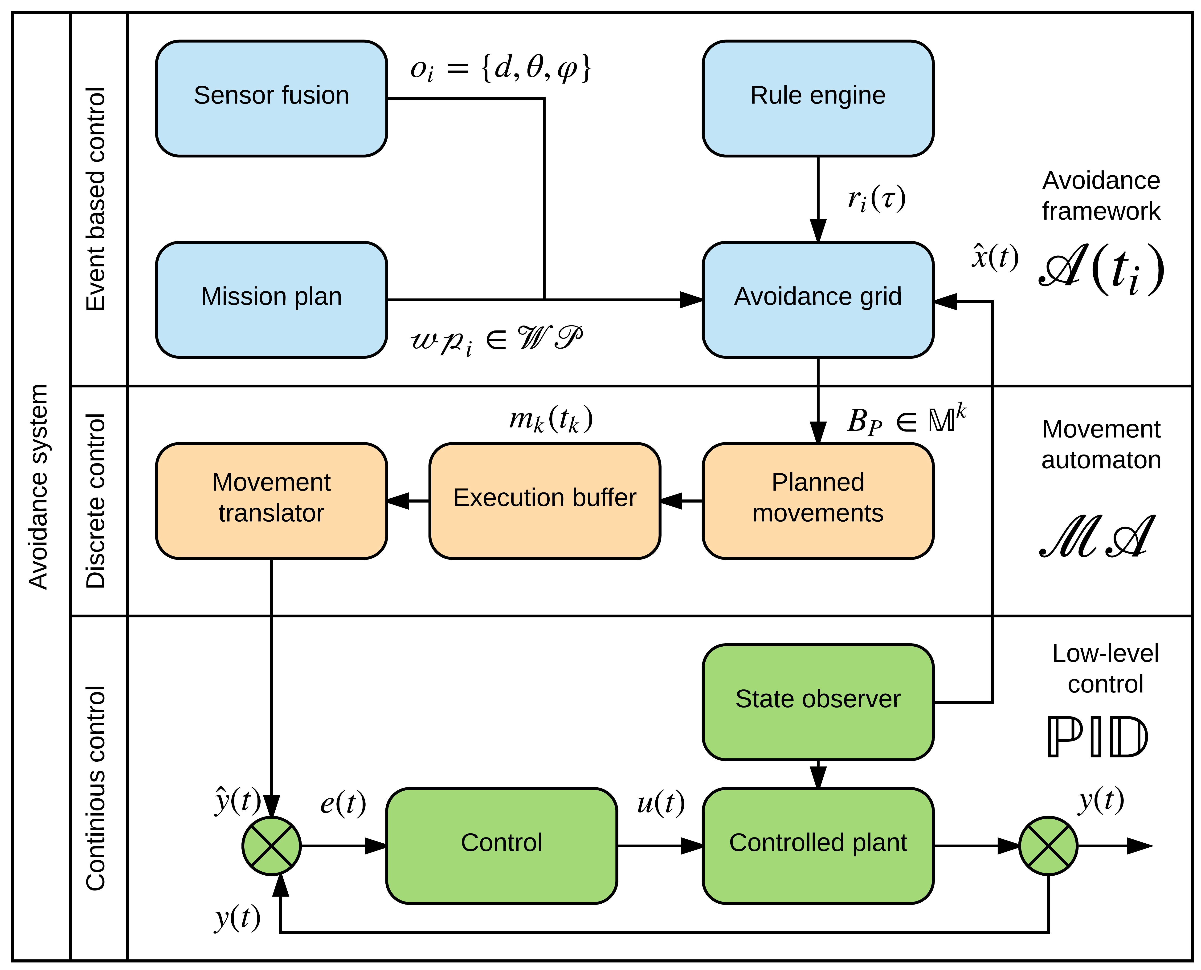
Avoidance Framework

Slide 4
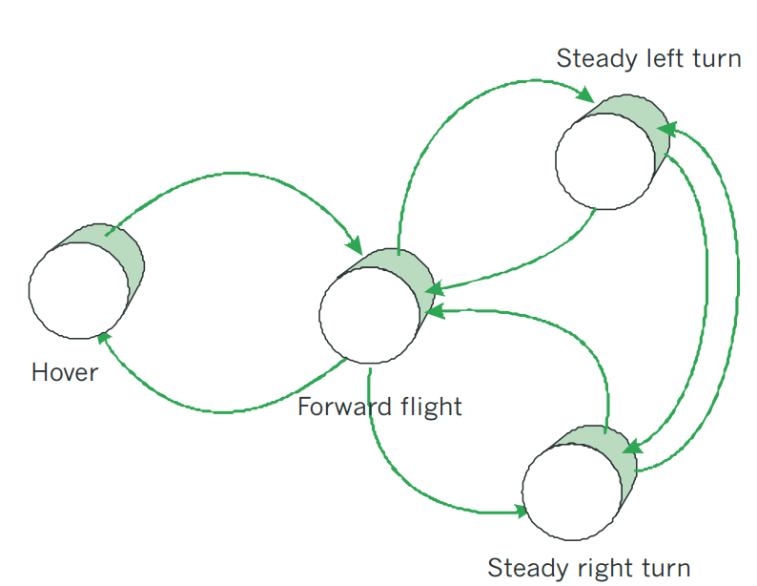
Movement Automaton - Control Interface
Decouple:
Optimal control problem
Navigation problem
Movement automaton:
Open hybrid automaton
Finite set of movements
For Simulation/control
Discrete chain of commands: hover(20s), left(10s),fly(12s)

Slide 5
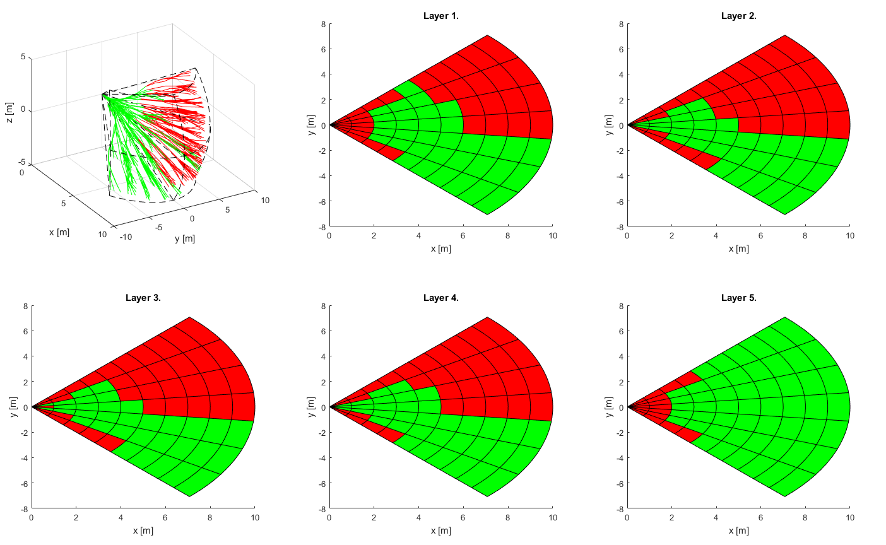
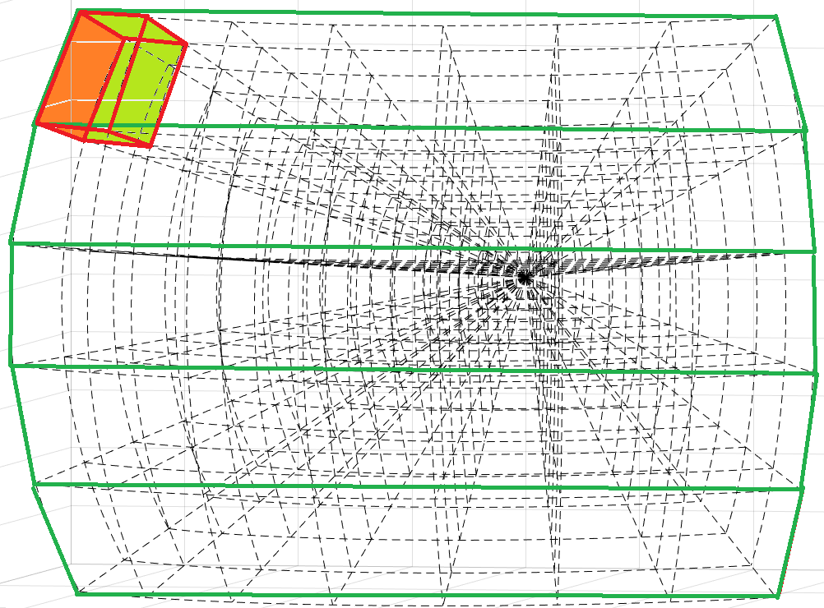
Avoidance Grid – Space Segmentation
Planar grid segmentation:
Cone reflecting effective decision range
Cell range defined by movement set
Cells increasing size with distance
Cell (10,1,1)
Top
Top-Middle
Horizontal layers
Middle
Bottom-middle
Bottom

Slide 6
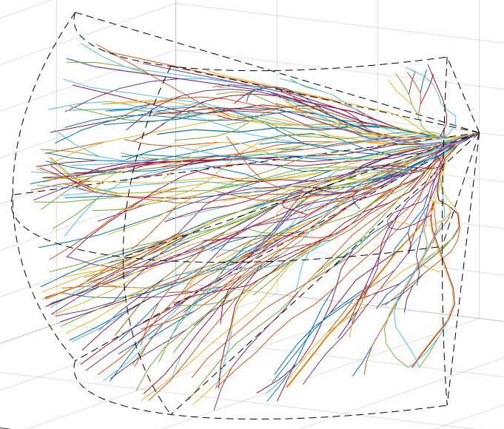
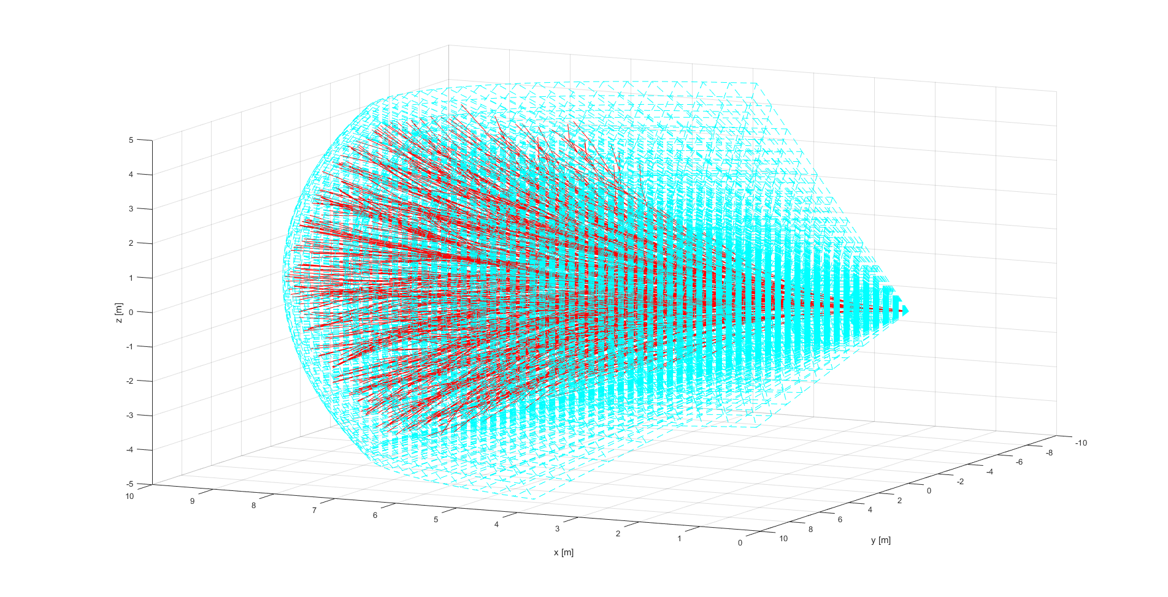
Reach Set Estimation
Representation:
Tree of movement chains
Bounded by FOV
Estimation process:
Load full reach set by given state
Prune Reach set according obstacle set
Issues:
Global vs Local state disparity
Proportional state space distribution
Calculate many proto reach sets
Approximation accuracy
Pick apropretiate movement set

Slide 7
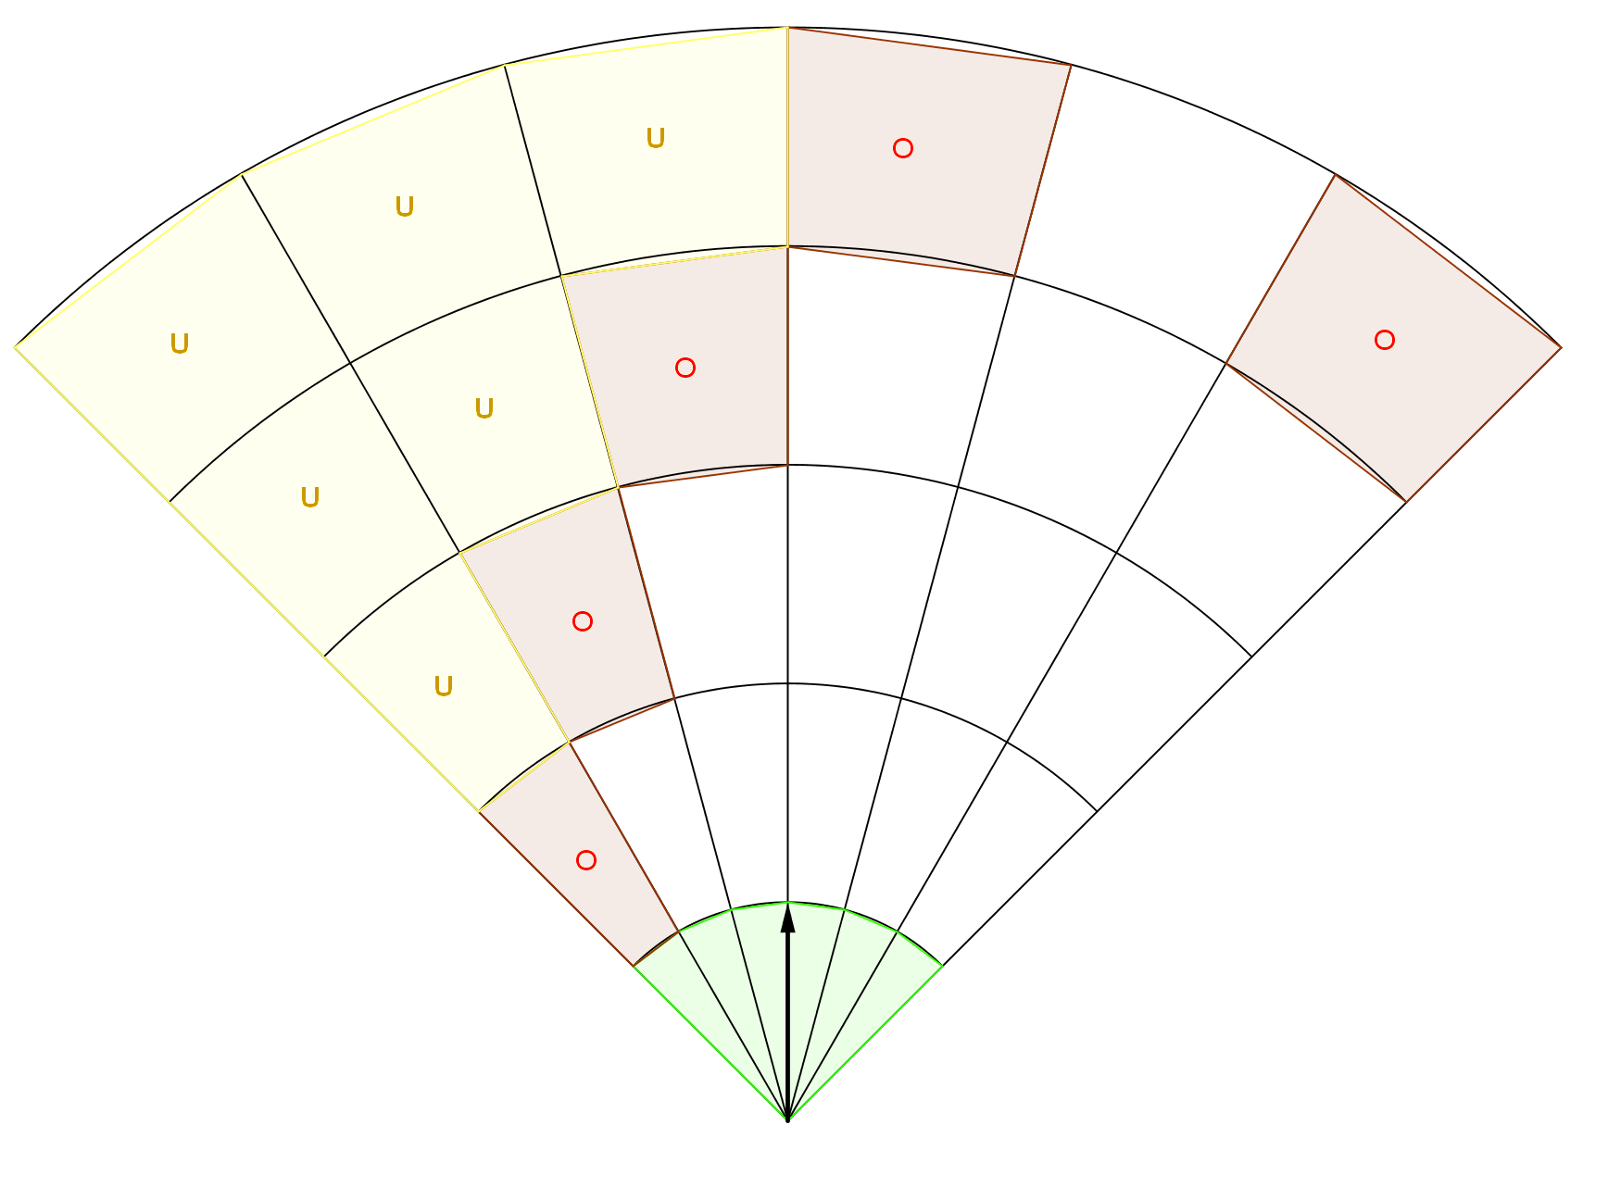
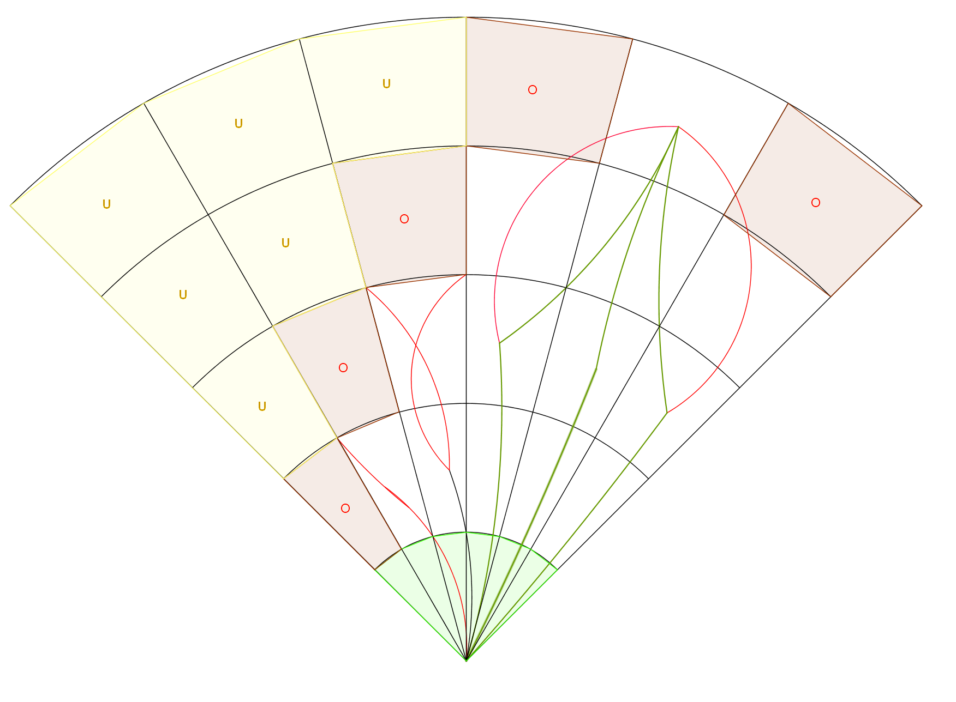
Space Assessment – Avoidance Grid
1. Space segmentation:
Determine Obstacle cells
Select Uncertain cells
Load proto-reach set:
state of vehicle x
dynamic constraints
2. Reach set pruning:
Remove unfeasible trajectories from proto-reach set
Green – feasible
Red - unfeasible

Slide 8
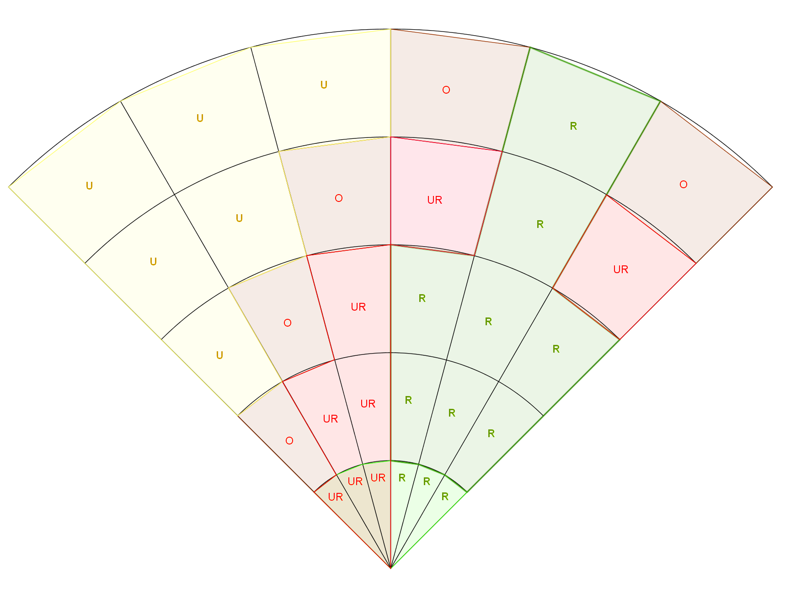
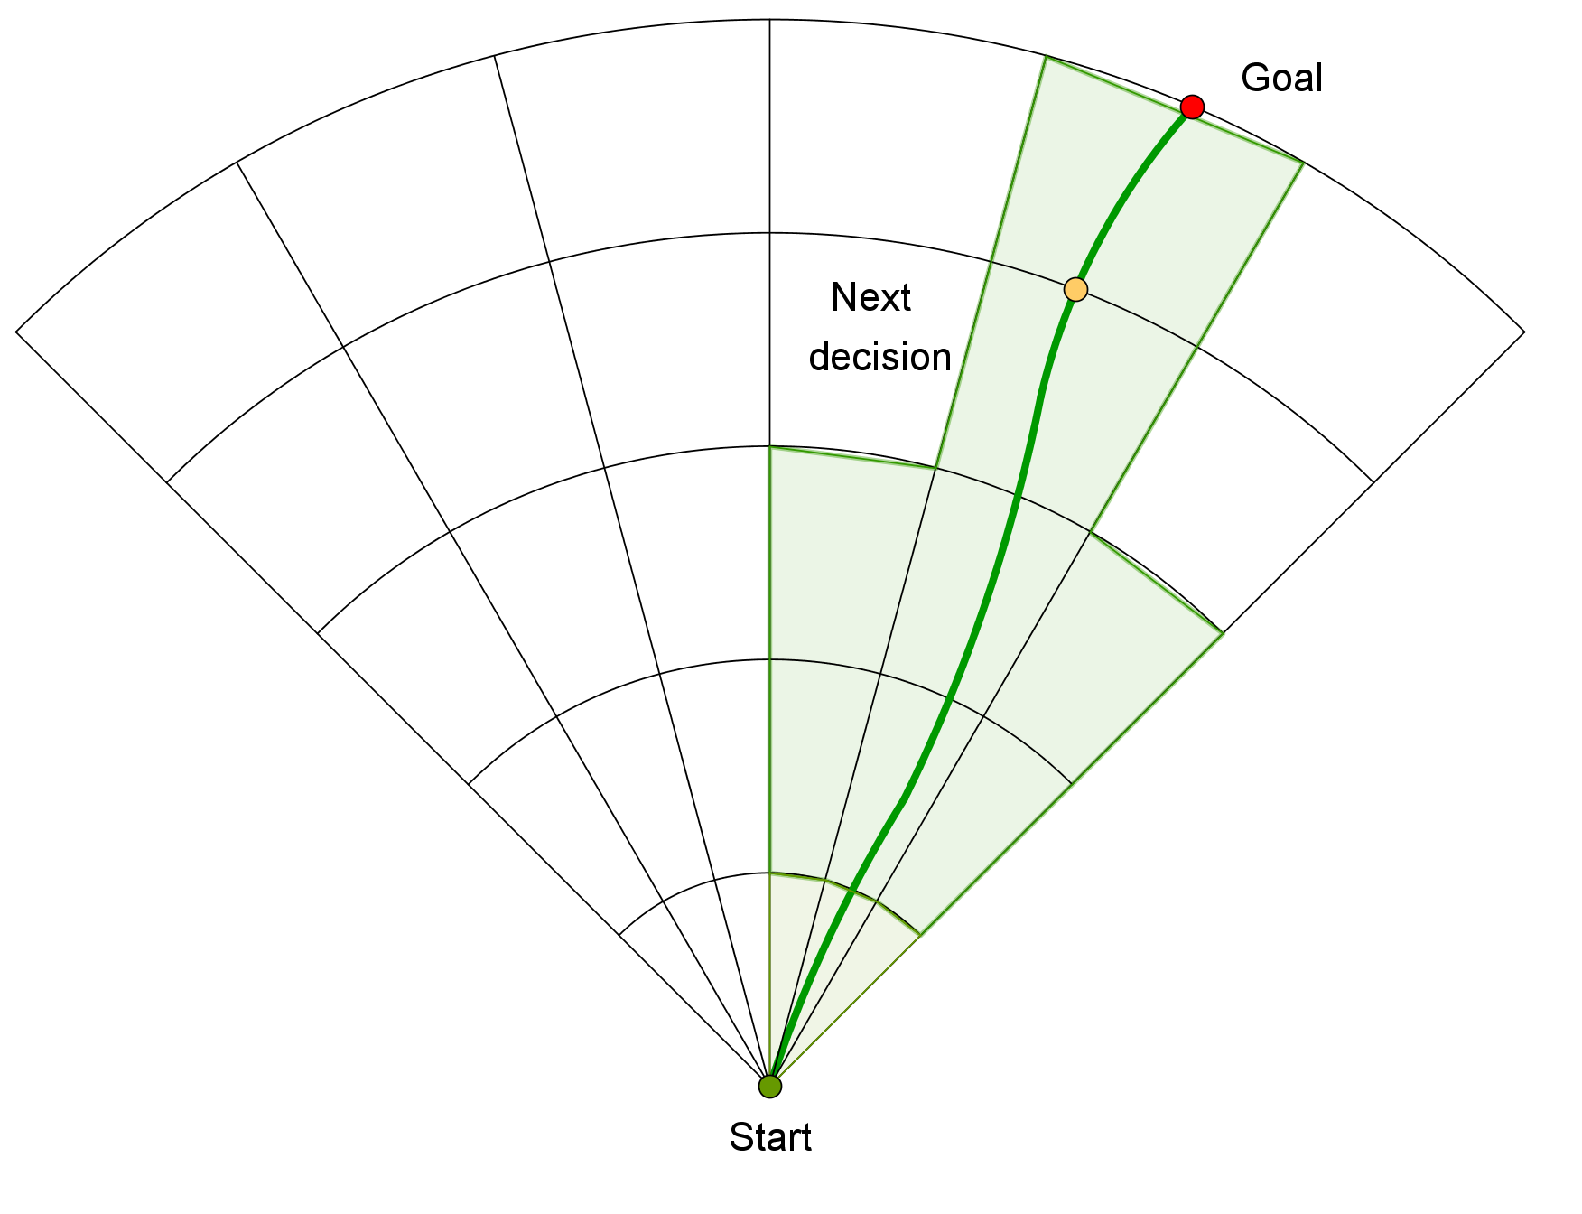
Avoidance Phase – Avoidance Grid
3. Reachable Space assessment:
For free cells assess:
Reachable:
At least one passing trajectory exists
Unreachable:
Otherwise
4. Trajectory selection
Select trajectory based on distance to waypoint criterion
Next decision point is planned

Slide 9
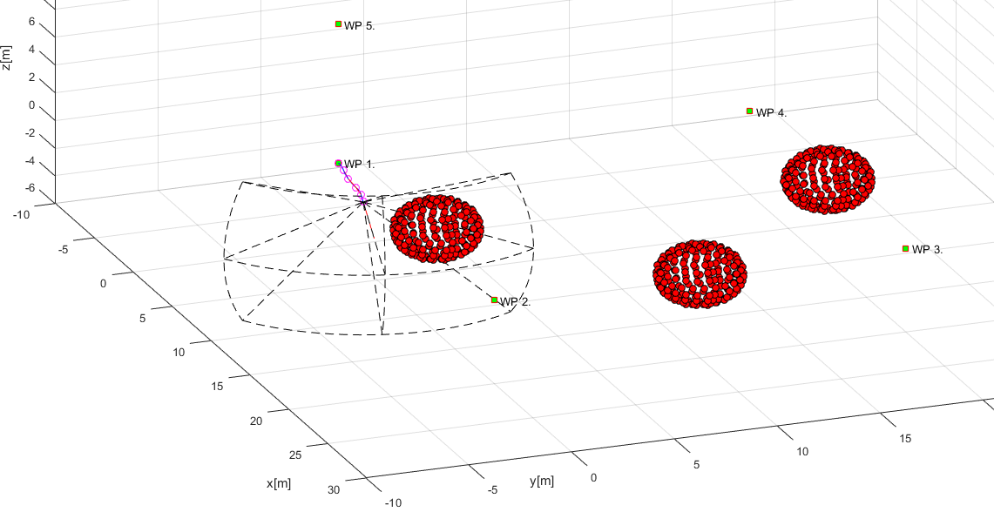
Simulation
Map obstacle
FOV boundary
Start WP
Obstacle in FOV
Path
Goal WP

Slide 10
Avoidance Grid State
Un-Reachable
Reachable

Slide 11
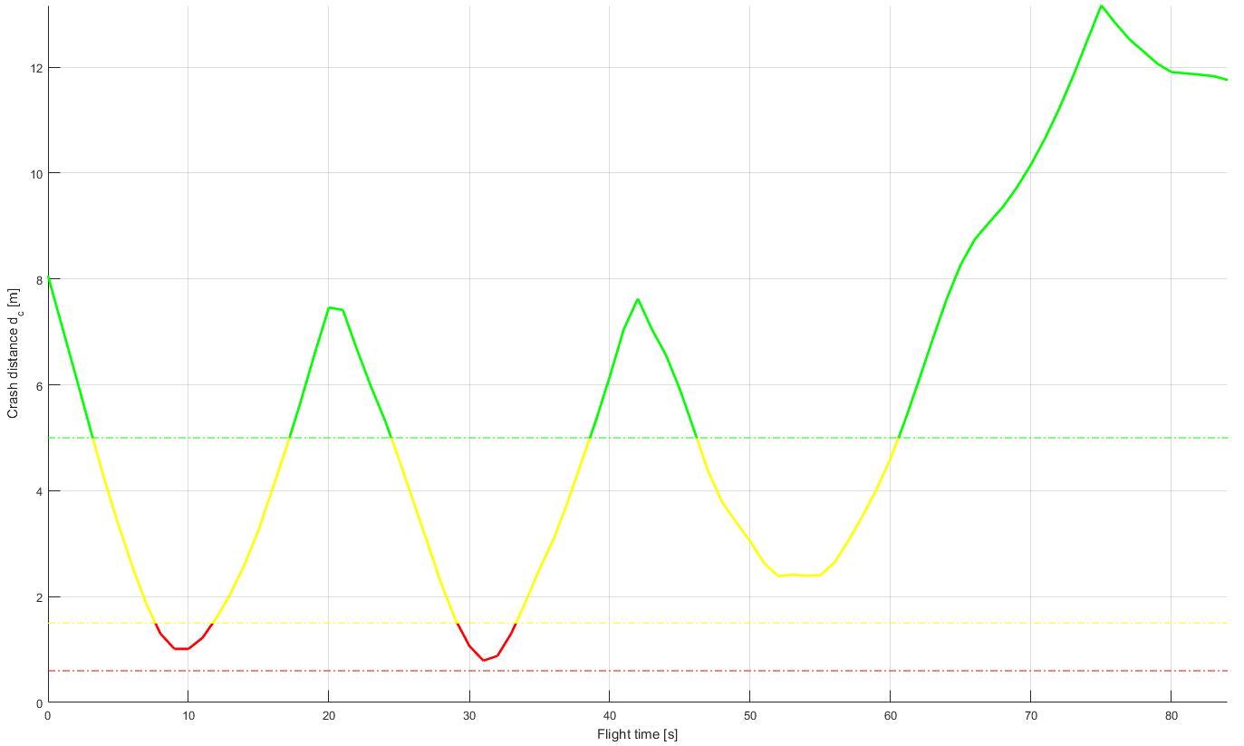



Static Obstacles – Crash Distance Performance
5
1
2
3
4
Conservative methods
$${ O}_{1}$$
$${ O}_{2}$$
$${ O}_{3}$$
Adaptive methods
Our method
Crash zone

Slide 12
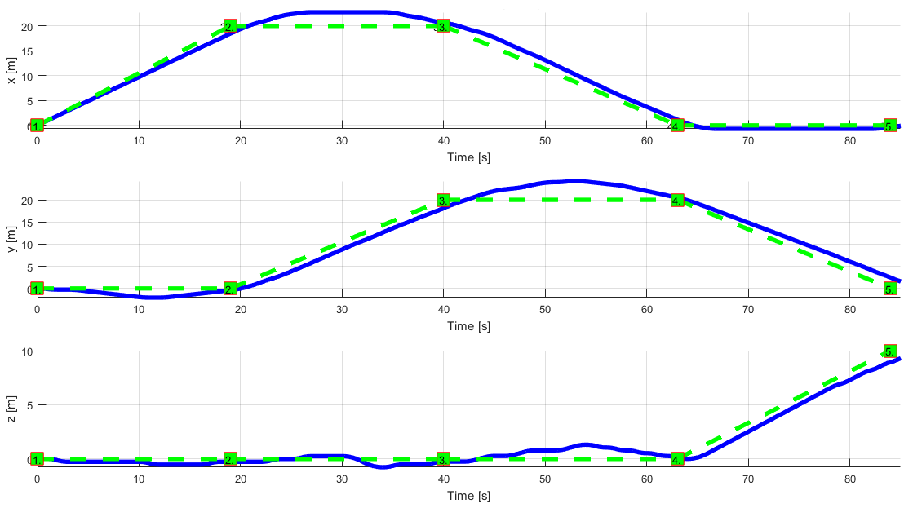
Static Obstacles – Trajectory Tracking Performance
Planned trajectory
Waypoint X.
Real trajectory

Slide 13
Conclusion
What we have:
Framework concept proven on open space environment
Movement automaton acts as interface to Control
Reach set estimation method with finite calculation time
Navigation algorithm considering static obstacles
Future research heading:
Data fusion considering multiple information sources
Map obstacles, from multiple sources
Intruders, from ADS-B sensor

